Slide 1


Clinical Trial Transparency
What should
German universities do
Published under a Creative Commons license.
Anyone may share or re-use parts or all of this presentation without seeking permission. CC-BY 3.0.

Slide 2


What are clinical trials?
Treatment
Group
(new drug)
OUTCOMES
Control group
(old drug or no drug)
Group of patients
OUTCOMES
Randomization
Compare outcomes
benefits
harms

Slide 3
Presentation structure
1 The problem
2 Solutions
3 German universities
4 How to fix this

Slide 4
Presentation structure
1 The problem
2 Solutions
3 German universities
4 How to fix this

Slide 5

Would you take these pills?
What the FDA saw:
74 trials total
38 trials had positive results
36 trials had negative results

Slide 6
Would you take these pills?
What independent scientists and doctors saw:
52 trials total
49 trials had positive results
only 3 trials had negative results

Slide 7
What happened here
Trials done: 74
Trials visible: 52
Source: Erick Turner et al. 2008. “Selective Publication of
Antidepressant Trials and Its Influence on Apparent Efficacy” (NEJM)

Slide 8
1. Publication bias
The results of around half of trials never get published
Trials done: 74
Trials visible: 52
 |  |  |  |  |  |  | X
 |  |  |  | X | X | X | X | X | X
X | X | X | X | X | X | X | X | X | X
X | X | X | X | X | X
Source: Erick Turner et al. 2008. “Selective Publication of
Antidepressant Trials and Its Influence on Apparent Efficacy” (NEJM)

Slide 9
1. Publication bias
The results of around half of all trials never get published
Trials with negative results are far less likely to get published
Trials done: 74
 |  |  |  |  |  |  | X
 |  |  |  | X | X | X | X | X | X
X | X | X | X | X | X | X | X | X | X
X | X | X | X | X | X
One positive trial not published
22 negative trials not published
Source: Erick Turner et al. 2008. “Selective Publication of
Antidepressant Trials and Its Influence on Apparent Efficacy” (NEJM)

Slide 10
What happened here
Trials done: 74
Trials visible: 52
 |  |  |  |  |  |  | X
 |  |  |  | X | X | X | X | X | X
X | X | X | X | X | X | X | X | X | X
X | X | X | X | X | X
Source: Erick Turner et al. 2008. “Selective Publication of
Antidepressant Trials and Its Influence on Apparent Efficacy” (NEJM)

Slide 11
2. Evidence distortion
Negative trials misreport outcomes as positive
11 negative trials reported as positive
Trials done: 74
Trials visible: 52
 |  |  |  |  |  |  | X
! | ! | ! | ! | ! | ! | ! | ! | ! | !
! |  |  |  | X | X | X | X | X | X
X | X | X | X | X | X | X | X | X | X
X | X | X | X | X | X
Source: Erick Turner et al. 2008. “Selective Publication of
Antidepressant Trials and Its Influence on Apparent Efficacy” (NEJM)

Slide 12
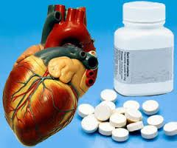
Case study 1: Lorcainide
Anti-arrhythmic drug
US approval in 1980
Widely used in patients who had suffered heart attacks
1980 academic trial with unusual deaths unpublished
Dangers only recognized in 1988
“20,000 to 75,000 lives were lost each year in the 1980s in the United States alone” (JAMA)

Slide 13

Case study 2: Reboxetine
Antidepressant
EU and US approval in 1990s
Safer than alternatives and just as effective
Cost: 4x as high as other antidepressant drugs
Data on 74% of trial participants had remained invisible
Long IQWIG battle for full data from Pfizer
Harms understated
Effectiveness still contested

Slide 14

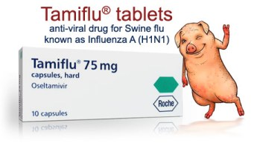
Case study 3: Tamiflu
Influenza drug
US and EU approval in 1999 & 2002
$18 billion total sales
96 countries stockpiled enough Tamiflu for 350 million people
Results from 8 trials not published
Cochrane battle for full data took four years
Nobody had full access to all data (WHO, EMA, FDA, CDC)
Conclusion: may do more harm than good
WHO removed from essential medicines list in 2017

Slide 15
These problems are not isolated
198 deaths were recorded in clinical trials of four new drugs, but only 29 deaths were fully reported in journals…
(2016 study)
Only 11% of publications in journals provided a complete and consistent account of all serious adverse events experienced by trial participants…
(2015 study of 300 clinical trials)
Out of 455 completed trials involving children, 96 had never published results anywhere. Tens of thousands of children had participated in these trials…
(2016 study)
35% of results from all clinical trials of 15 drugs allowed onto the market remained unpublished and hence invisible…
(2015 study)
Only 9 trials out of 67 published in top medical journals were accurately reported…
(2016 study)

Slide 16

No transparency means…
Treatment efficacy and harms unclear
Public health funds misspent
Research funding wasted
Scientific progress slowed down

Slide 17

Important: It’s not just Big Bad Pharma
Research consistently shows that universities perform worse than industry at registering clinical trials and publishing their results.

Slide 18
Presentation structure
1 The problem
2 Solutions
3 Policy asks
4 TranspariMED

Slide 19



Solution: Trial registration
Advantages:
Stops trials from “disappearing”
Prevents moving of goalposts
All key information in one place
265,000 studies
56,000 trials

Slide 20
Solution: Trial registration
MANDATORY
Declaration of Helsinki 2013
  Article 35: “Every research study involving human subjects must be registered in a publicly accessible database before recruitment of the first subject.”
  Any clinical trial not doing this is unethical

Slide 21
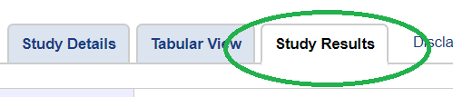

Solution: Post results on registries
Advantages:
Faster results sharing
More accurate data
Prevents non-publication
Easy to locate
Public access – no paywall

Slide 22
Solution: Post results on registries
MANDATORY
European Union directive 2014
  Every clinical trial registered on the EU Clinical Trial Register (EudraCT) must post results there 12 months after completion
  Institutions (= universities) are responsible for compliance
  After 2020 member states may impose fines

Slide 23
Solution: Post results on registries
MANDATORY
FDA Amendments Act (Final Rule) 2017
  Some clinical trials registered on Clinicaltrials.gov (including some foreign-sponsored trials) must post results within 12 months
  Institutions (= universities) are responsible for compliance
  Fines up to $11,000 per day if results are late

Slide 24
Solution: Post results on registries
VOLUNTARY
WHO Joint Statement 2017
  Every clinical trial must post results onto registries 12 months after completion
  Also applies to trials on DRKS and ISRCTN
  Institutions (= universities) are responsible for compliance
  Funders pledge to monitor… and cut funding

Slide 25
Presentation structure
1 The problem
2 Solutions
3 German universities
4 How to fix this

Slide 26
Trial registration
2018 study (IntoValue, QUEST / BiH)
  75% of all clinical trials run by German universities were not prospectively registered
  All these trials were unethical
  Shows lack of strong policies and oversight
  Threatens ability to publish results in high impact journals (ICMJE requirement)

Slide 27
Results publication (I)
2018 study (IntoValue, QUEST / BiH)
  27% of clinical trials run by German universities never published their results anywhere (not on registries + not in journals)
  Total of 433 trials involving >50,000 patients
  Immense waste of research funds
  Reaction: IQWIG called for funding cuts for universities that fail to publish trial results

Slide 28
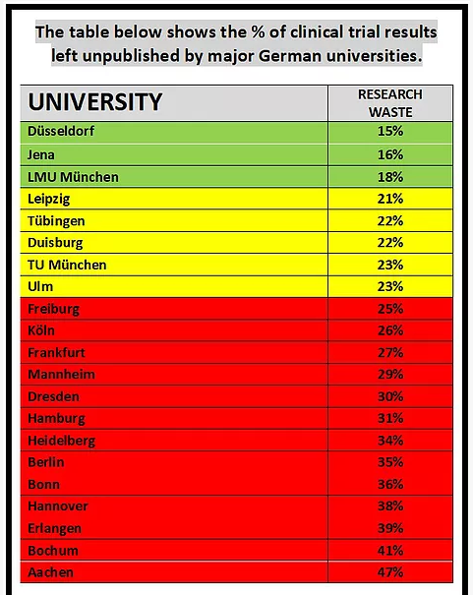
Results publication (II)

Slide 29
Posting results on registries (I)
Performance of German vs other universities
Germany (EU registry)
  Charite 3% of results posted
  Heidelberg 0% posted
  Munich (LMU) 7% posted
  Münster 59% posted ☺
Other countries (EU registry / FDAAA trials)
  Oxford: 93% posted
  King’s College: 93% posted
  Johns Hopkins: 100% posted
  Yale: 100% posted

Slide 30
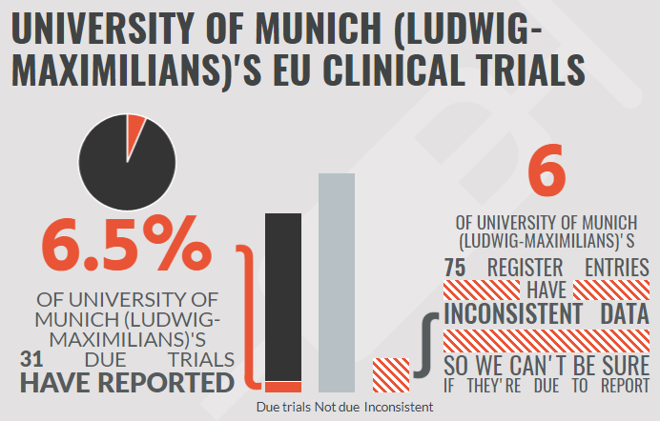
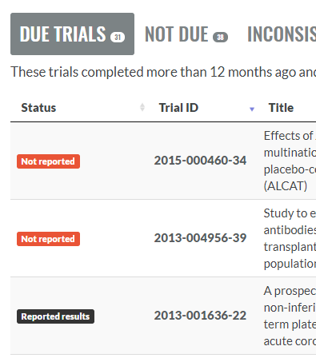
Posting results on registries (II)
Now check your own institution’s performance:
eu.trialstracker.net/

Slide 31
Posting results on registries (III)
KEY POINTS
  Universities are responsible (not individuals)
  Universities can do better
  Universities must do better
    Ethical imperative
    Integral part of research excellence
    Risk of funding cuts (e.g. Wellcome Trust)
    Threat of legal liability and fines
IMPORTANT: Results posted onto trial registries can afterwards still be published in high impact journals (it’s ICMJE policy, and Oxford researchers clearly still manage to publish…)

Slide 32
Presentation structure
1 The problem
2 Solutions and progress
3 Policy asks
4 How to fix this

Slide 33

Recent progress in Britain
Late 2018: Parliamentary enquiry discovers that universities are still failing to post results onto trial registries: “Unacceptable”
Parliament gives universities a deadline:
Must improve performance by summer 2019
Public research funders begin to monitor whether grantees register trials and post results
Early 2019: Performance significantly improved
End 2019 target: 100% EU registry results posted

Slide 34
What did British universities do?
STEP 1: Central oversight over trial registries
Create unified university registry accounts
Research Governance team controls accounts
Lessons learnt:
One central registry manager (part-time role)
Stop free-for-all chaotic registrations
Prevent multiple registrations
Ensure quality of all new registrations

Slide 35
What did British universities do?
STEP 1: Central oversight over trial registries
Create unified university registry accounts
Research Governance team controls accounts
Top lesson learnt:
Preventing problems is MUCH easier than fixing them later.
Sooner or later, universities will have to do this anyway
The sooner you start, the less clean-up work you will have to do
Lessons learnt:
One central registry manager (part-time role)
Stop free-for-all chaotic registrations
Prevent multiple registrations
Ensure quality of all new registrations

Slide 36
What did British universities do?
STEP 2: Audit existing registry entries
Search registries and create list of all old trials
Identify trials that never published results anywhere and contact their PIs
Update all registry entries
Lessons learnt:
You will find a terrible mess ☹
Post all results onto the EU registry (it’s the law)
On the other registries, post results for all old trials that remain completely unpublished

Slide 37
What did British universities do?
STEP 3: New policies and processes
All trials must be registered before they start
All trials must post results onto registries within 12 months
Lessons learnt:
Go beyond narrow legal compliance
Fully align with WHO best practices
Write clear Standard Operating Procedures
Make sure researchers understand new rules

Slide 38
What did British universities do?
STEP 4: Support researchers
Either fully manage registry entries for them, or
Provide training and support
Lessons learnt:
Not yet clear which model works best
More efficient to centralise some tasks
EU registry is very difficult for novices to use
Much easier if trial designs integrate registry reporting formats from the outset

Slide 39
What did British universities do?
STEP 5: Monitor registry entries (ongoing)
Research Governance unit tracks all trials
Ensure all registry entries are kept updated
Ensure all trials post results within 12 months
Lessons learnt:
Email reminders to Principal Investigators
Research Governance unit may need top-level support to ensure senior academics comply
Very easy to run once a good system is in place

Slide 40



Resources

Slide 41
Resources
  TranspariMED website:
  Case studies by universities
  Policy checklist
  AllTrials user guide for registries
www.transparimed.org/resources
Twitter: @TranspariMED
Email: tillbruckner@gmail.com

